Slide 1
CSE 109 Electrical Circuits
Dr. Md. Forkan Uddin
Associate Professor
Department of Electrical and Electronic Engineering (EEE)
Bangladesh University of Engineering and Technology (BUET)

Slide 2
Series DC Circuits
Boylestad - Chapter 5

Slide 3
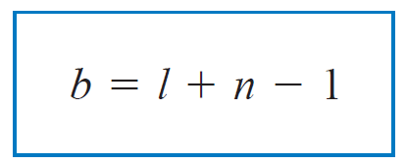
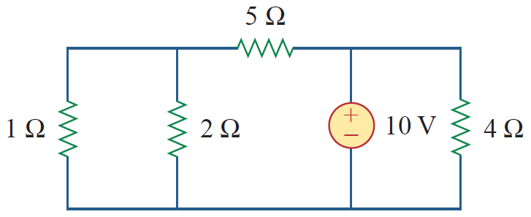
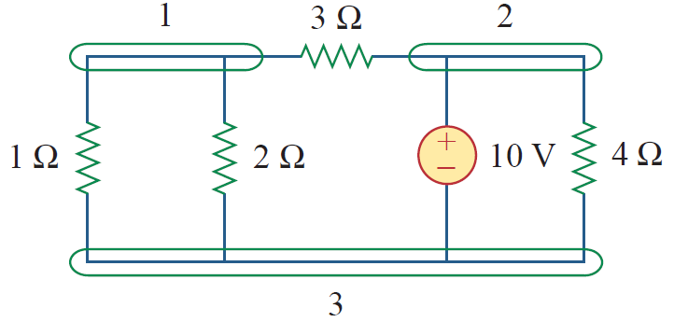
Nodes, Branches and Loops
Branch (b)
Represents a single element such as a voltage source or a resistor
Node (n)
Point of connection between two or more branches
Loop (l)
Any closed path in a circuit
A loop is said to be independent if it contains at least one branch which is not a part of any other independent loop
l = 3, b = 5, n = 3

Slide 4
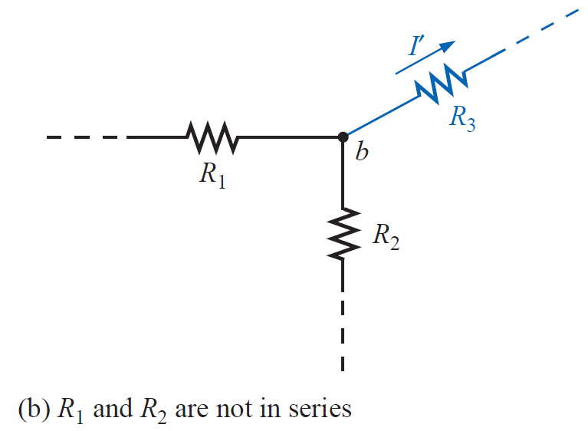
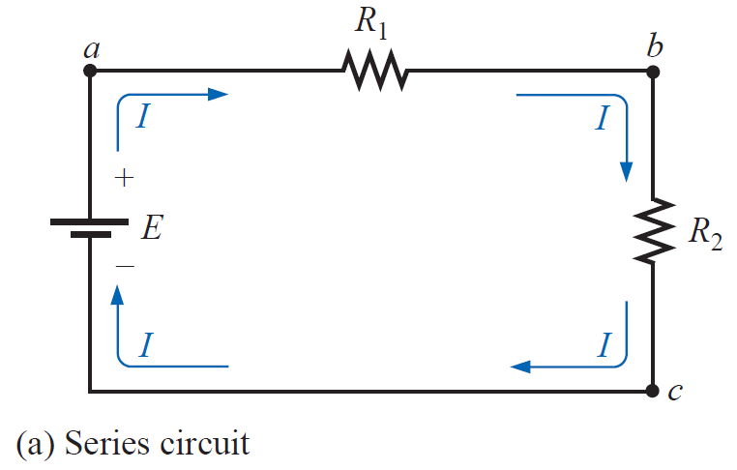
Series Elements
Two elements are in series if -
1. they have only one terminal in common , and
2. the common point between the two elements is not connected to another current-carrying element
Series elements carry the same current

Slide 5
Series Resistors

Slide 6
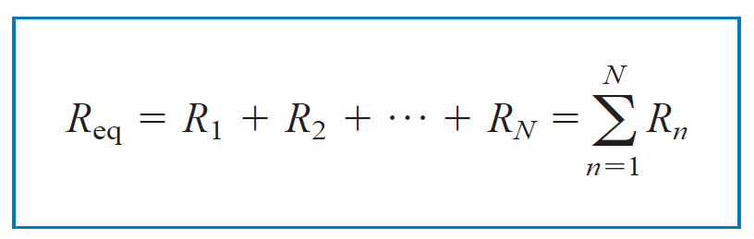

Series Resistors
or, R_{eq}
or, R_{eq}
The total resistance of a series circuit is the sum of the individual resistances
For N equal resistance connected in series,

Slide 7
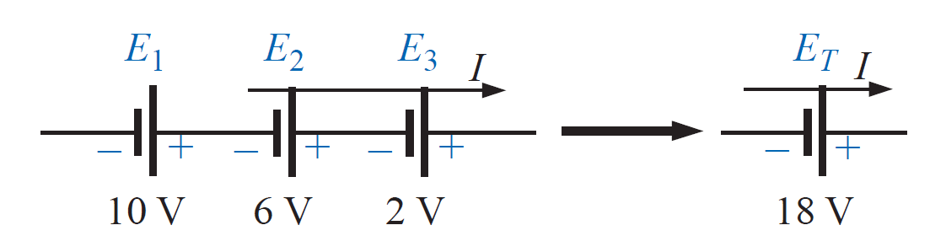
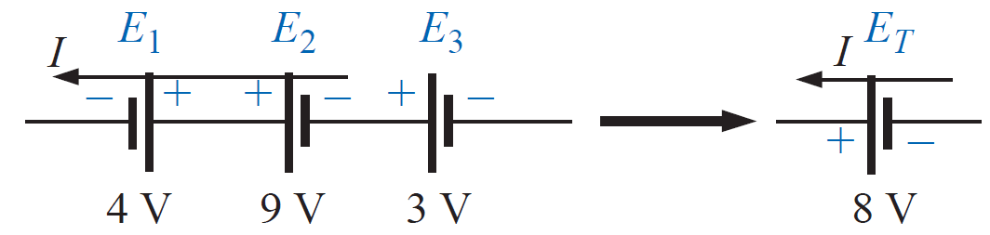
Voltage Sources in Series

Slide 8
Voltage Sources in Series
Series connection of dc supplies: (a) four 1.5 V batteries in series to establish a terminal voltage of 6 V; (b) incorrect connections for two series dc supplies; (c) correct connection of two series supplies to establish 60 V at the output terminals.

Slide 9
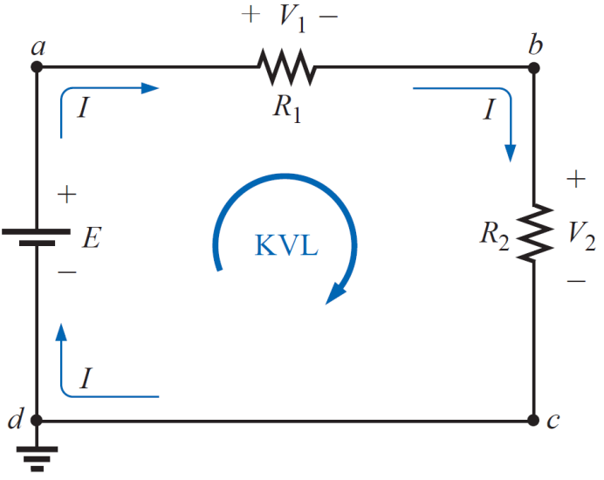
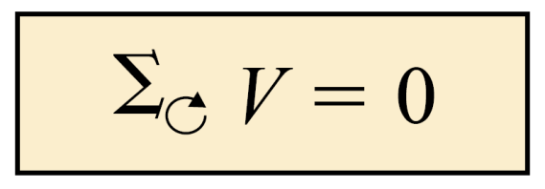
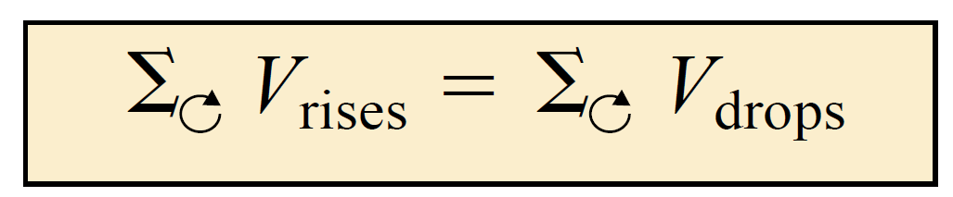
Kirchhoff’s Voltage Law (KVL)
The algebraic sum of all voltages around a closed path (or loop) is zero
Voltage –
Rise: +ve
Drop: -ve
Alternatively:
The sum of the voltage rises in a loop is equal to the sum of the voltage drops across the series elements

Slide 10
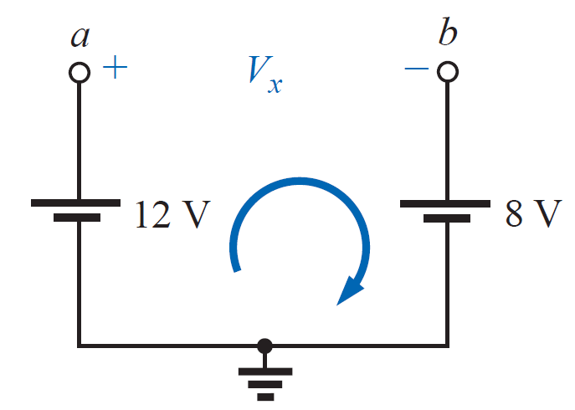
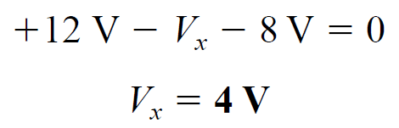
Kirchhoff’s Voltage Law (KVL)
The application of Kirchhoff’s voltage law does not need to follow a path that includes current-carrying elements – applicable around open circuit

Slide 11
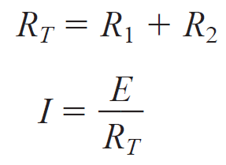
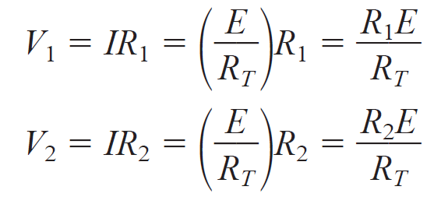
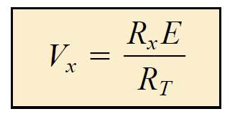
Voltage Divider Rule (VDR)
Applicable for series circuits
Applying Ohm’s law,
Voltage Divider Rule (VDR)

Slide 12
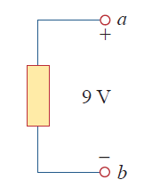
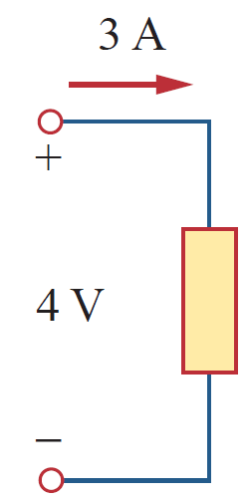
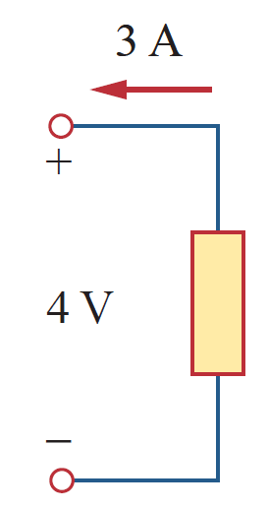
Sign Conventions
Current
(from High-to-low potential)
I_{ab} = V_{ab} /R = (V_{a} – V_{b})/R
Voltage Rise
Voltage Drop
Power Delivered
Power Absorbed

Slide 13
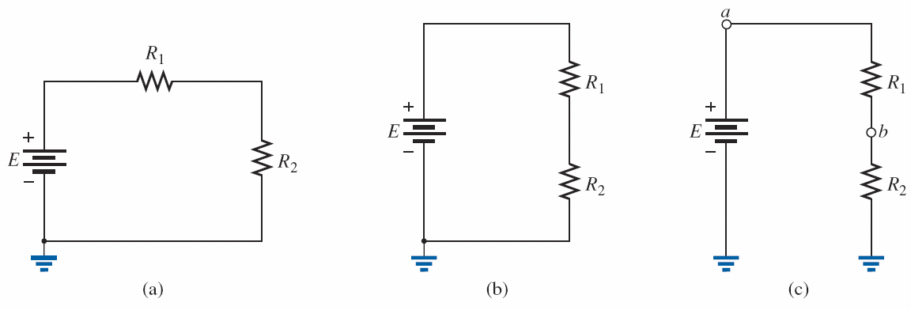
Notations
Three ways to sketch the same series dc circuit.

Slide 14
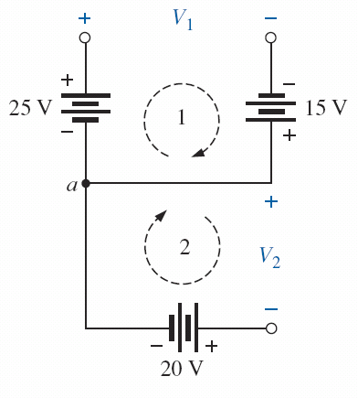
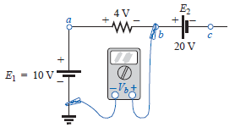
Example: KVL
Find V₁ and V₂ for the network (use KVL)
Find the voltages Va, V_{b}, V_{c}, and V_{ac} for the network
V_{a} = 10 V
V_{b} = 6 V
V_{c} = -14 V
V_{ac} = 24 V
V₁ = 40 V
V₂ = -20 V

Slide 15
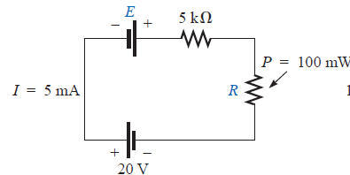
Example: KVL
Evaluate the value of E and R

Slide 16
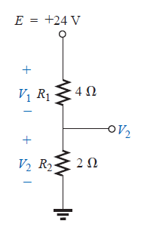
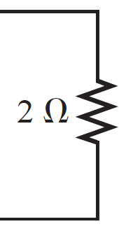
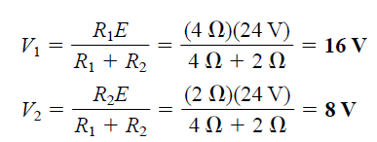
Example: VDR
Using the voltage divider rule, determine the voltages V1 and V2
Using the voltage divider rule, determine the voltages V1 and V2

Slide 17
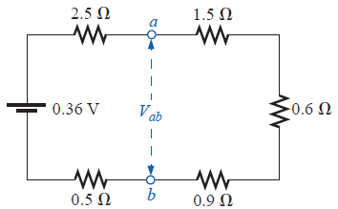
Example: VDR
Using the voltage divider rule, determine the voltage V_{ab}

Slide 18
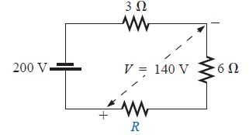
Example: VDR
Using the voltage divider rule, determine the unknown resistor R

Slide 19
Reading
Boylestad - Chapter 5

